Slide 1

PREDICTION OF PARKINSON DISEASE USING MACHINE LEARNING ALGORITHM
Name: DHILIPKUMAR M
Reg No: 18MIS1112
Course Title: Capstone project
Course code : SWE4099
Project Guide: Dr. PRABHAKARAN R
Project Coordinator: Dr. Rabindra Kumar Singh

Slide 2
Guide Approval mail snapshot

Slide 3
ABSTRACT:
Parkinson's Disease (PD) is a progressive neurodegenerative disorder that affects a person's motor skills, causing tremors, stiffness, and difficulties in walking and performing daily activities. Early and accurate diagnosis of PD can greatly improve patients' quality of life and prognosis. The traditional methods of diagnosing PD include a clinical evaluation, imaging studies, and laboratory tests. However, these methods can be time-consuming and expensive, and they may not always provide accurate results. In recent years, machine learning algorithms have been increasingly used to aid in the diagnosis of PD. In this project aims to develop a predictive model for Parkinson's disease using machine learning algorithms. Two popular algorithms, Support Vector Machines (SVM) and eXtreme Gradient Boosting (XGBoost), were employed to train and test the model using a dataset consisting of voice data of Parkinson's patients. The performance of the two algorithms was evaluated and compared based on metrics such as accuracy, precision, recall, and F1-score.

Slide 4
INTRODUCTION
Parkinson's disease (PD) is a chronic and progressive movement disorder that affects millions of people worldwide.
Early diagnosis and accurate prediction of PD can help in the effective management and treatment of the disease.
Machine learning (ML) algorithms have shown great potential in diagnosing and predicting PD using various speech or voice recordings dataset.
In this project, we aim to develop an ML-based model for the diagnosis and prediction of PD using speech or voice data.
The dataset used in this study contains voice rec data from individuals with and without PD, along with various speech or voice dataset.
Two popular ML algorithms, Support Vector Machines (SVM) and XGBoost, are used to train and evaluate the model.

Slide 5
PROBLEM STATEMENT
Most of the people suffering with PD are observed to be physically and emotionally draining.
They even feel depressed, trouble concentrating on things, painful spasms etc.
PD has a large spectrum of clinical features ranging from motor to non motor symptoms.
Some of the motor symptoms are hypophonic speech, rigidity, resting tremor.
Non-motor symptoms are as hallucinations, depression, constipation, sleeping disorders, cognitive impairment, and impulse control disorders.
Non motor symptoms show sickness than motor symptoms.

Slide 6
PARKINSON'S DISEASE SYMPTOMS
Parkinson's disease symptoms can be different for everyone. Early signs are mild that goes unnoticed. Symptoms usually begin on one side of your body and gets worsen on that side, afterwards it affects both the sides. Parkinson's symptoms may include
Tremor • Slowed movement • Rigid muscles. • Impaired posture and balance.
• Loss of automatic movements • Speech changes • Writing changes

Slide 7
HOW IT CAUSE :-
The Parkinson's disease is due to a loss of neurons that produce a chemical messenger in the brain called dopamine. when there is a decrease in level of the amino acid named dopamine it leads to the abnormal brain activity, which leads to Parkinson’s disease. The cause of Parkinson's disease is still a question mark, but several factors appear to play a role, including:
• Genes • Environmental • Triggers

Slide 8
OBJECTIVE
The voice dataset of Parkinson's disease from the UCI Machine learning repository is used as input.
In this project aims to develop a predictive model for Parkinson's disease using machine learning algorithms.
Two popular algorithms, Support Vector Classifier (SVM) and eXtreme Gradient Boosting (XGBoost), were employed to train and test the model using a dataset consisting of vocal or speech data of Parkinson's patients.
The performance of the two algorithms was evaluated and compared based on metrics such as accuracy, precision, recall, and F1-score.

Slide 9
PROPOSED SYSTEM
Prognosis and progression of Parkinson’s disease is a critical question among the clinicians since there is a disparity of parameters taken into the diagnostic consideration thereby making the decision process difficult.
Different datasets have been independently explored and applied through machine learning to analyze the incidence of occurrence and progression of the disease.
The present project is an updated report of the types of Machine Learning algorithms which have gained prominence within a span of last 5 years.
Further it highlights the use of hybrid intelligence models to improve the prediction accuracy and sensitivity over standalone SVM and XGBoost methods.
ADVANTAGE:
More accurate • Loss is less • Running time is less compared to previous models

Slide 10
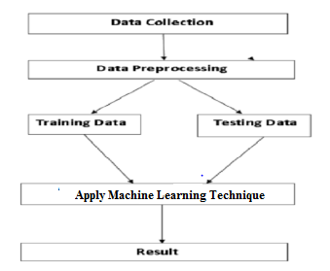
4.2 Proposed System Diagram

Slide 11
LIST OF MODULES
Data Collection
Data Preprocessing
Splitting Of Data
Applying Machine Leaning Algorithm Technique
Clasification Of Parkinson Disease

Slide 12
DATA COLLECTION
Speech or voice data is assumed to be 90% helpful to diagnose a person for identifying presence of disease.
In general, Person with PD suffer from speech problems, which can be categorized into two: hypophonia and dysarthria.
Hypophonia indicates very soft and weak voice from a person and dysarthria indicate slow speech or voice , that can hardly be understood at one time and this causes because of damage to central nervous system.
The voice dataset of Parkinson's disease from the UCI Machine learning library is used as input.

Slide 13
DATA PREPROCESSING
Missing values were imputed to guarantee that all the algorithms would be able to handle them.
Nevertheless, some algorithms could deal with missing values automatically without imputation, such as XGBoost.
To restrict the comparison complexity, the missing values were imputed based on their data type.
For numerical data types, the missing entries are replaced by the median value of the complete entries. For categorical data, the missing entries were replaced by the mode value of the complete entries.

Slide 14
SPLITTING OF DATA
After preprocessing the data, data is normalized in training and testing the model. When data is spitted then we train algorithm on the training data set and keep test data set aside. This training process will produce the training model based on logic and algorithms and values of the feature in training data. Basically aim of feature extraction is to bring all the values under same scale.
A dataset used for machine learning should be partitioned into three subsets — training, test, and validation sets.
Training set: -A data scientist uses a training set to train a model and define its optimal parameters — parameters it has to learn from data.
Test set: - A test set is needed for an evaluation of the trained model and its capability for generalization. The latter means a model’s ability to identify patterns in new unseen data after having been trained over a training data. It’s crucial to use different subsets for training and testing to avoid model over fitting, which is the incapacity for generalization we mentioned above.

Slide 15
ALGORITHM USED
Support Vector Machine(SVM)
XGBoost

Slide 16
ALGORITHM EXPLAINED :- SUPPORT VECTOR MACHINE (SVM)
SVM (support vector machine) is supervised machine learning technique used to classify the data. SVM provides higher accuracy than the other classification techniques. The basic idea behind SVM is to maximize the margin of data by discovering the best possible separating hyper plane. In the fig there are multiple hyper planes which separate the data but best one is chosen. After that to get the margin, the difference between hyper plane and the closest data point is computed and double this value. There are multiple hyper planes in Figure. But choose the best hyper plane which helps to classify the data accurately. SVM provides higher accuracy than the other classification techniques.

Slide 17
XGBOOST:
XGBoost stands for Extreme Gradient Boosting, which was proposed by the researchers at the University of Washington.
A tree can be “learned” by splitting the source set into subsets based on an attribute value test.
This process is repeated on each derived subset in a recursive manner called recursive partitioning.
The recursion is completed when the subset at a node all has the same value of the target variable, or when splitting no longer adds value to the predictions.

Slide 18
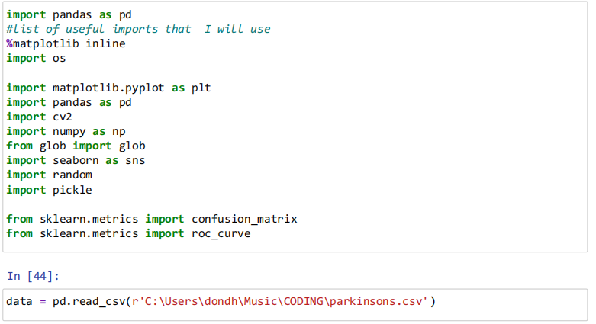
IMPLEMENTATION
Import necessary modules

Slide 19
Data Preprocessing
Code
data.columns
data.info()
data.describe()
data.isnull().sum()
data.isnull().any()
data.corr()
data['status'].value_counts()

Slide 20
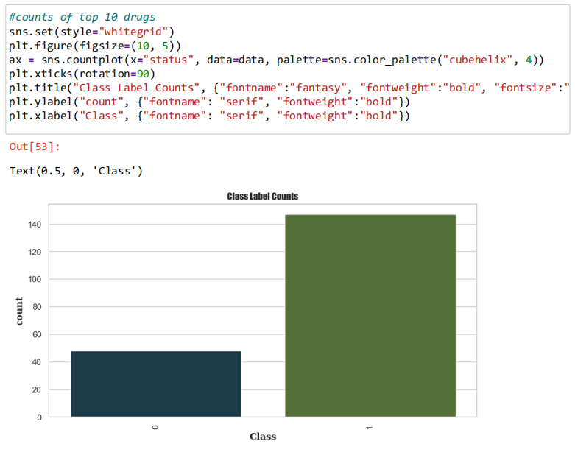
Splitting Of Data

Slide 21
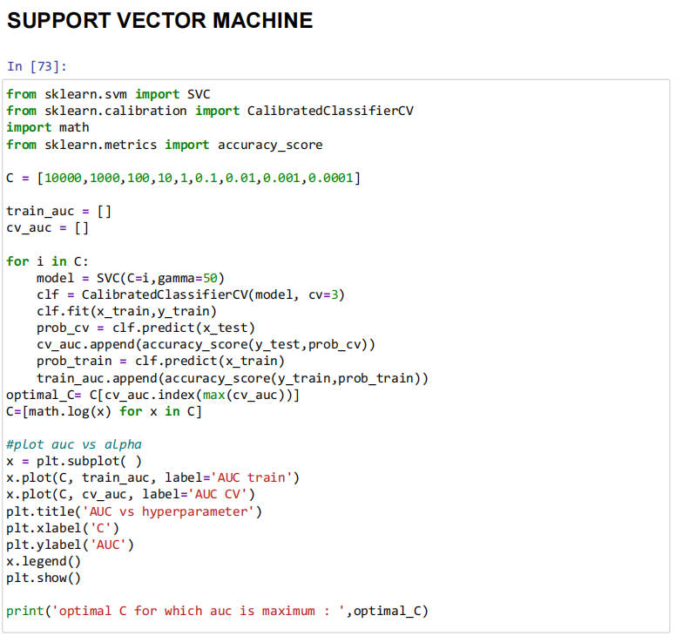
SUPPORT VECTOR MACHINE

Slide 22
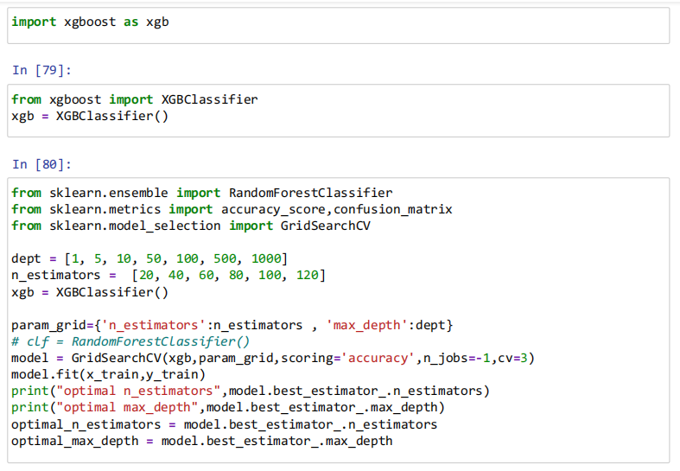
XGBoost

Slide 23
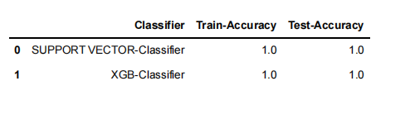
RESULT
The experiment's findings demonstrated that the SVM and XGBoost algorithms may be used to
build a machine learning model on the data to predict Parkinson's illness. Anaconda was used
for the front end and Jupyter Notebook for the back end. Both the SVM and the XGBoost algorithms
exhibited 100% prediction accuracy, according to an evaluation of both algorithms' accuracy.
Due to their excellent accuracy, these algorithms may one day help in the diagnosis of
Parkinson's disease.

Slide 24
FUTURE WORK
In the future, we may build on this research by investigating different methods for anticipating
Parkinson's disease using a variety of datasets. Currently, we categorise patients using a binary property (1 for patients with diseases, 0 for patients without diseases).
Future research will instead categorise individuals and identify various Parkinson's disease stages using a range of features

Slide 25
Reference :-
[1] Raundale, P., Thosar, C., & Rane, S. “Prediction of Parkinson’s disease and severity of the disease using Machine Learning and Deep Learning algorithm”. 2021
[2] Abdelhakeem, S. K., Mustafa, Z. M., & Kadhem, H. “Diagnosing Parkinson’s Disease Based on Voice Recordings” (2023, January).
[3] Karan B, “Speech-Based Parkinson’s Disease Prediction Using XGBoost-Based Features Selection and the Stacked Ensemble of Classifiers.” 2023.
[4] Liu, W., Liu, J., Peng, T., Wang, G., Balas, V. E., Geman, O., & Chiu, H. W. “Prediction of Parkinson’s disease based on artificial neural networks using speech datasets.” 2022.
[5] Rohit Surya, A. T., Yaswanthram, P., Nair, P. R., Rajendra Prasath, S. S., & Akella, S. V. (2022). “Prediction of Parkinson’s disease using machine learning models—a classifier analysis.” (2021)

Slide 26
[6] Marwa Almasoud, Tomas E Ward2, “Parkinson Disease Gait Classification Based On Machine Learning Approach”, 2013.
[7] Sanghee Moon, Hyun-Je Song, Vibhash D. Sharma, Kelly E. Lyons, Rajesh Pahwa, “Classification Of Parkinson's Disease And Essential Tremor Based On Balance And Gait Characteristics From Wearable Motion Sensors Via Machine Learning”, 2020.
[8] Basetty Mallikarjuna, R. Viswanathan and Bharat Bhushan Naib, “Feedback-Based Gait Identification Using Deep Neural Network Classification”, 2020.
[9] Rana Zia Ur Rehman, Silvia Del Din, Yu Guan, Alison J. Yarnall, “Selecting Clinically Relevant Gait Characteristics For Classification Of Early Parkinson's Disease”, 2020.
[10] Milla Juutinen,Justin Zhu, Cassia Wang, “Perkinson's Disease Detection From 20-Step Walking Tests Using Inertial Sensors Of Smartphone”, 2020.

Slide 27
THANK YOU

